Slide 1
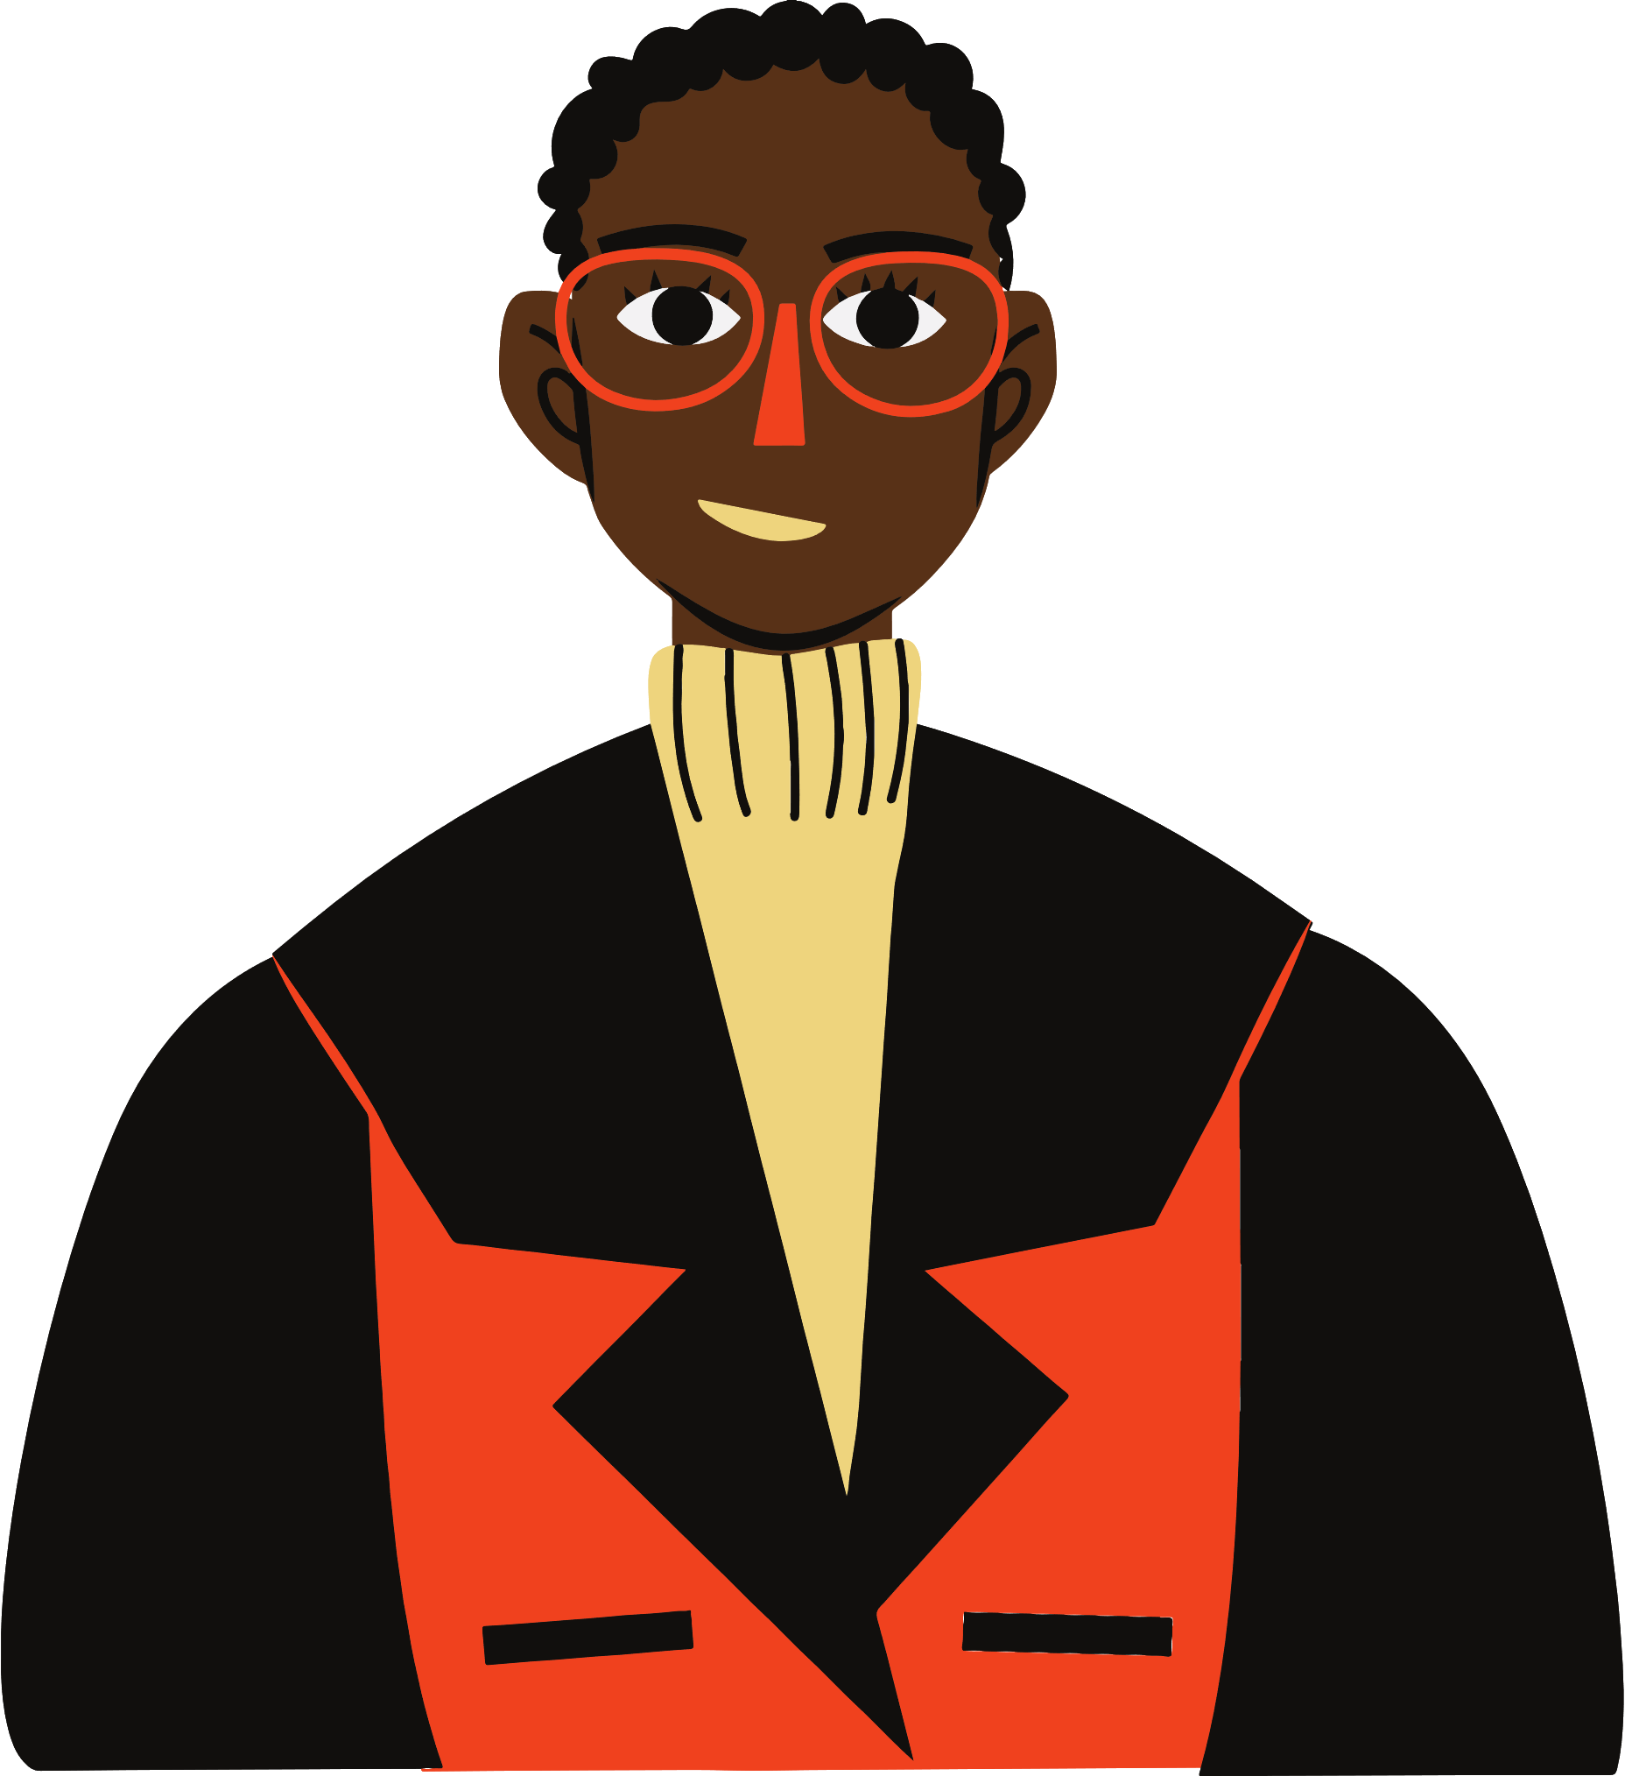

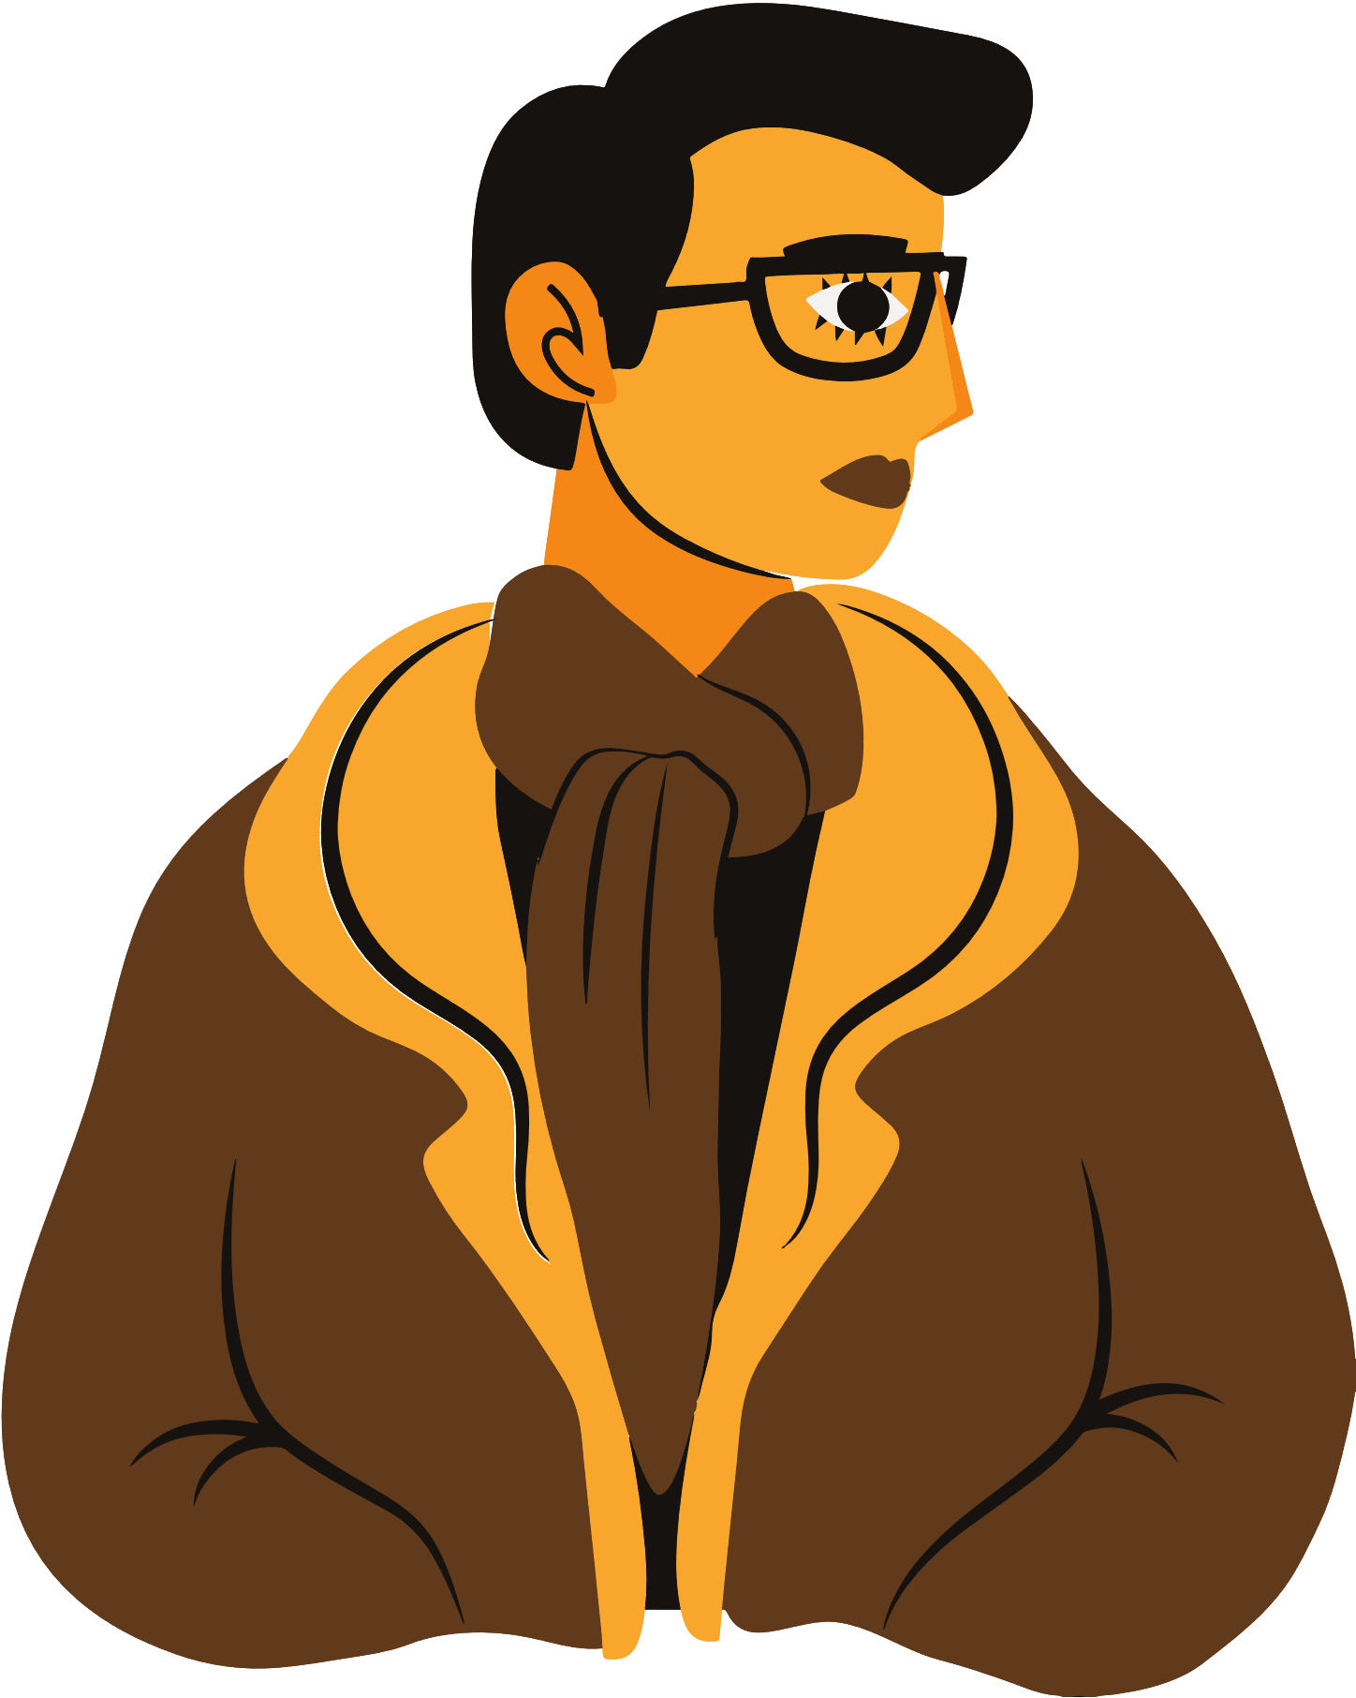
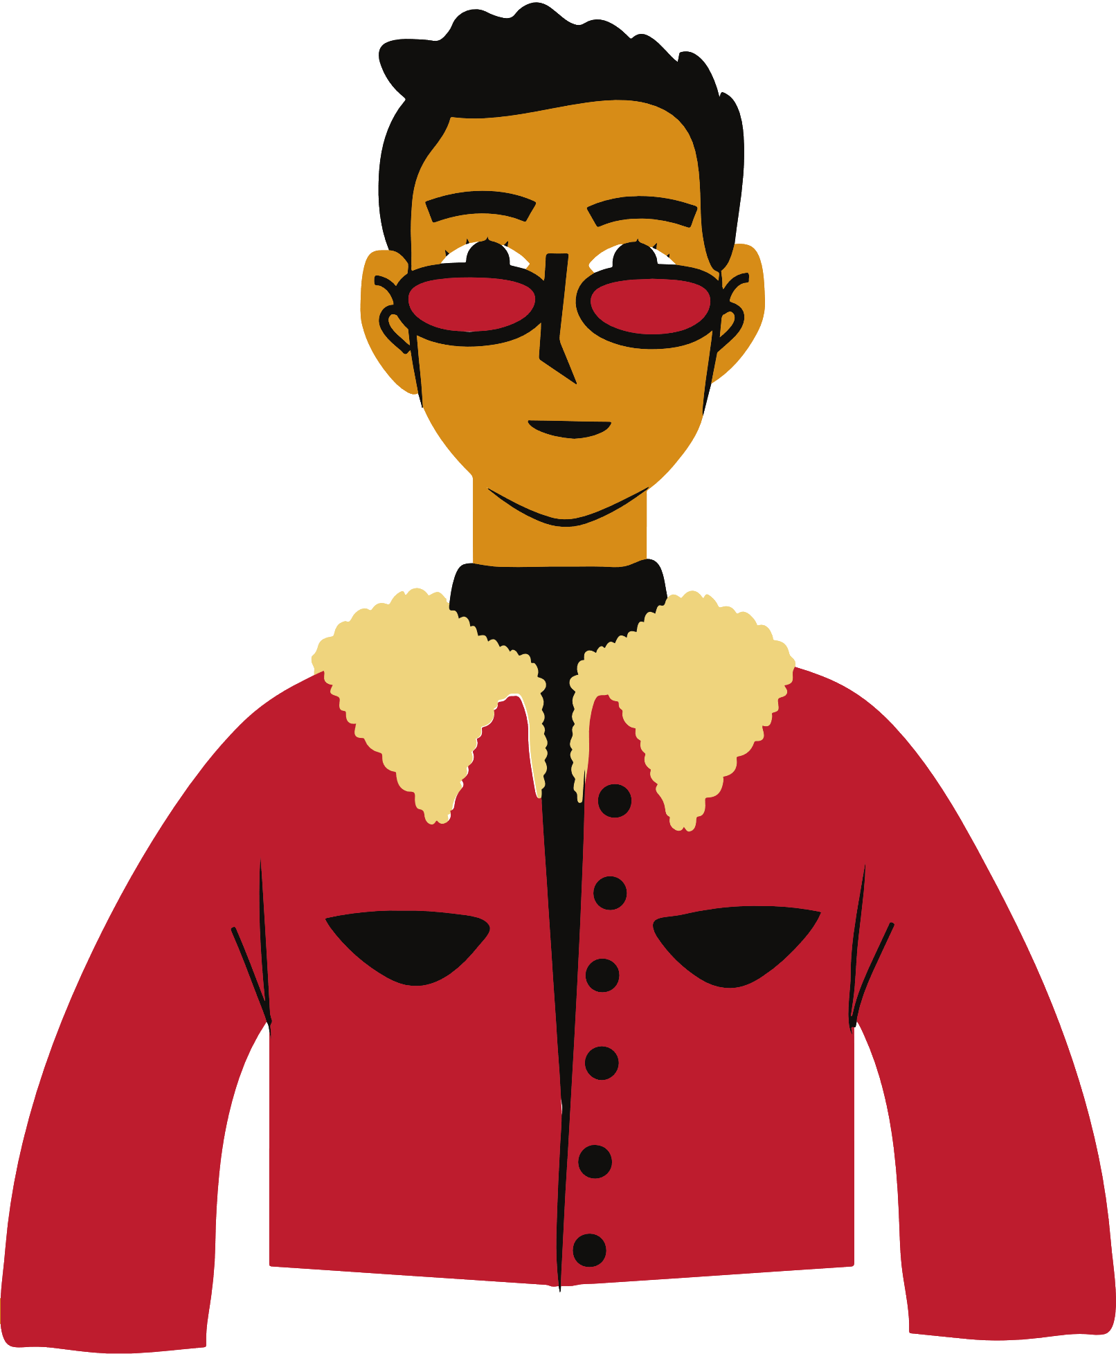

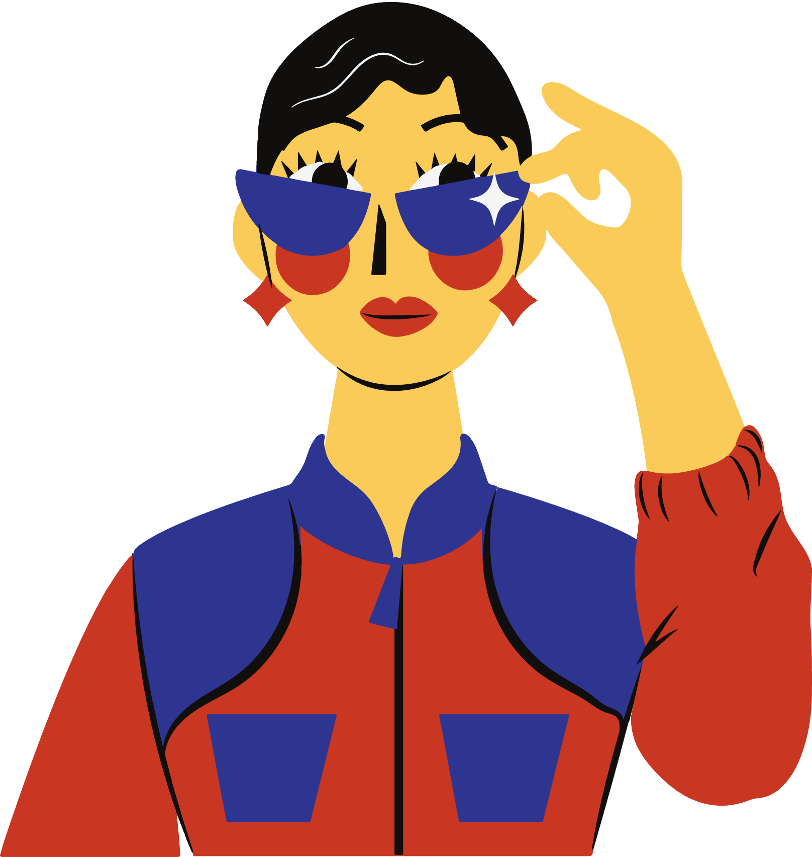

Gender classification
Nada mossad abodegham
AID S2
3203210097

Slide 2


Outline
Introduction
Related works
Proposed model
Results
References

Slide 3

Introduction
This project aims to develop a gender classification model based on facial features, encompassing long hair presence, forehead dimensions, nose characteristics, lip thinness, and the distance between the nose and lips.
On a societal level, the project seeks to contribute to gender equality. In the realm of security, integrating automated gender classification can enhance identification processes in public spaces and assist law enforcement agencies in investigations. Furthermore, the project's application extends to marketing and consumer analytics, offering potential benefits such as targeted advertising and insights into consumer behavior.
The approach involves data preprocessing including data visualization, data cleaning (handling missing values, handling the duplicates), predicting the outliers by box plot and dimensionality reduction using PCA, LDA, and SVD. The implementation of different machine learning algorithms and neural network are also achieved, performance will be gauged in terms of the model's accuracy, precision, recall, and confusion matrix.

Slide 4
Related works
Paper | year | methods | Dataset type | Results (accuracy)
[1] | 2023 | decision tree classification | measurements | 0.9842
[2] | 2023 | StyleGAN and VGG19 networks | images | 0.9478
[3] | 2022 | Random forest | Signature | 0.962
[4] | 2020 | KNN | voice | 0.968
[5] | 2021 | CNN | Fingerprint | 0.99
[6] | 2021 | SVM | Measurements | 0.96
[7] | 2021 | CNN | images | 0.9512
[8] | 2021 | BLSTM | Voice | 0.9176
[9] | 2023 | MS Kinect | Measurements | 0.975
[10] | 2023 | back propagation algorithm | Measurements | 0.7894

Slide 5

dataset description:
This dataset contains 5001 rows and 7 features and a label column(gender):
long_hair: This column contains 0's and 1's where 1 is "long hair" and 0 is "not long hair".
forehead_width_cm: This column is in CM's. This is the width of the forehead.
forehead_height_cm: This is the height of the forehead and it's in Cm's.
nose_wide: This column contains 0's and 1's where 1 is "wide nose" and 0 is "not wide nose.
nose_long: This column contains 0's and 1's where 1 is "Long nose" and 0 is "not long nose".
lips_thin: This column contains 0's and 1's where 1 represents the "thin lips" while 0 is "Not thin lips".
distance_nose_to_lip_long: This column contains 0's and 1's where 1 represents the "long distance between nose and lips" while 0 is "short distance between nose and lips".
gender: This is either "Male" or "Female".
The data contains no null values, and it has about 1768 duplicate. there is no need for binding because the algorithms will work with numerical data.

Slide 6

Proposed model

Slide 7

Preprocessing
Data visualization
Input data
Missing value handling
Bar char
Box plot
Duplicate handling
Histogram
Scatter plot
Ensuring datatypes
Training
Feature reduction
Data analysis
LDA
Statistical data
80-20
Data split
covariance
PCA
Correlation
Testing
Chi square
SVD
Z-test
ANOVA

Slide 8
Classification
Naïve bayes
Training
Bayesian belief
Decision tree
LDA
Neural network
KNN
Evaluation
Confusion matrix
accuracy
F1-score
Testing
Precision
Recall
ROC curve

Slide 9
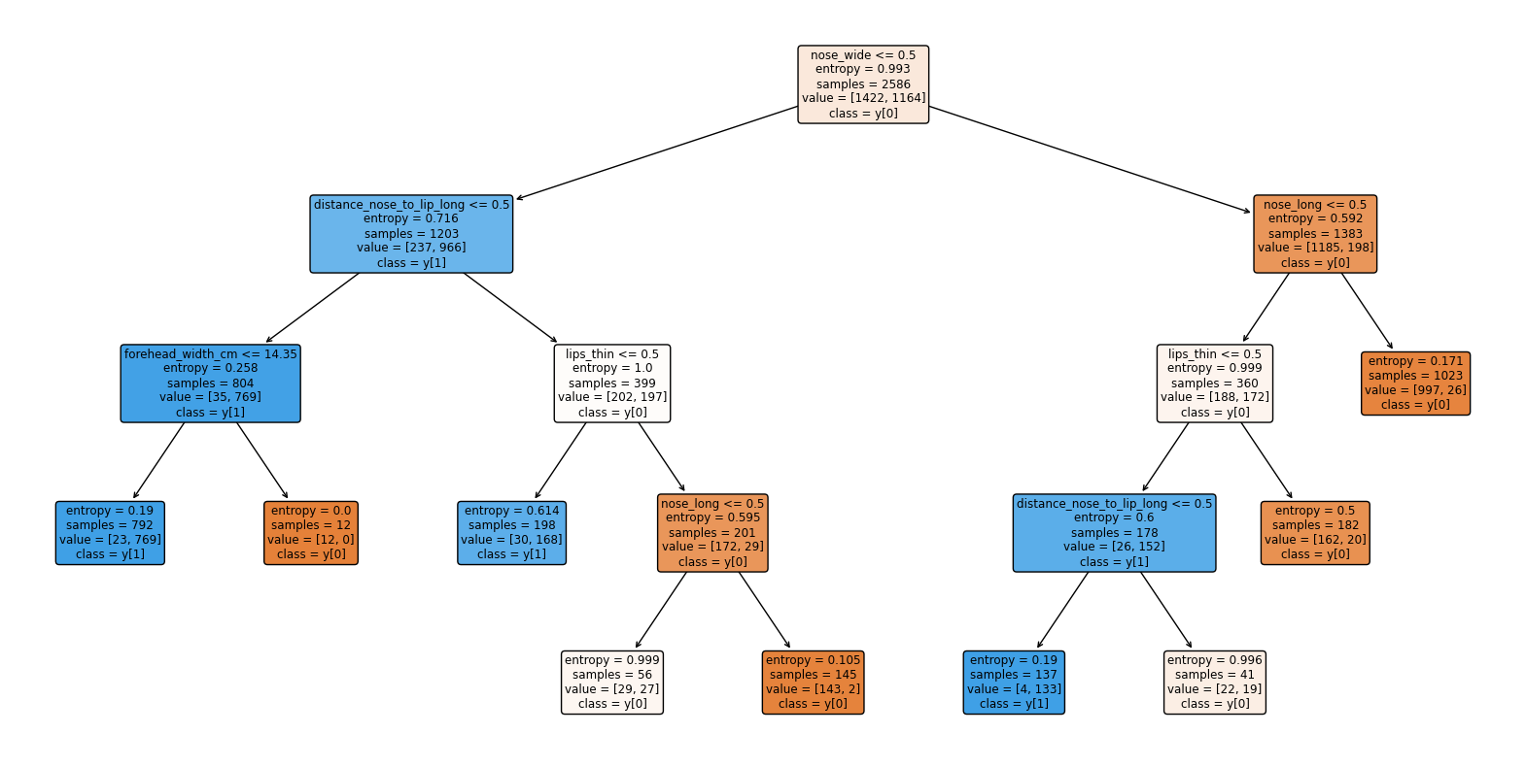
Models
The first model is the naïve bayes model which assumes independently between features of the data.
The second model is Bayesian belief network which oppose to naïve bayes, it assumes some dependency between the features, as target will be dependent on all the features.
The third model is a decision tree which build tree of feature to make it like condition to reach the target.

Slide 10
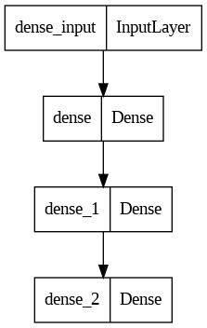
Models
The fourth model is LDA which try to separate the two classes by a straight line.
The fifth model is a neural network which consists of an input layer, hidden layer, and output layer.
The sixth model is KNN, which makes prediction make on the vote of k similarity.

Slide 11

Results
The model | Accuracy | Error rate | F1-score | Precision | Recall | ROC (auc)
Naïve bayes | 97.21% | 7.01 | 0.97 | 0.98 | 0.96 | 97.25%
Bayesian Belief Network | 55.79% | 286.0 | 0.71 | 0.55 | 1.0 | 50%
Decision Tree (Entropy) | 96.29% | 18 | 0.96 | 0.95 | 0.98 | 96.02%
Decision Tree (Error) | 95.05% | 15.02 | 0.95 | 0.95 | 0.95 | 95.02%
LDA | 96.59% | 14.01 | 0.96 | 0.96 | 0.97 | 96.44%
Neural network | 94.89% | 32 | 0.95 | 0.91 | 0.99 | 94.27%
KNN (Euclidean) | 97.06% | 7.01 | 0.97 | 0.98 | 0.96 | 97.11%
KNN(Minkowski) | 97.06% | 8.01 | 0.97 | 0.97 | 0.96 | 97.08%
KNN(Manhattan) | 96.90% | 8.01 | 0.97 | 0.97 | 0.97 | 96.94%

Slide 12

References
[1] Tabassum, H., Iqbal, M. M., Mahmood, Z., Parveen, M., & Ullah, I. (2023). Gender classification from anthropometric measurement by boosting decision tree: A novel machine learning approach. Journal of the National Medical Association.
[2] Raman, V., ELKarazle, K., & Then, P. (2023). Artificially Generated Facial Images for Gender Classification Using Deep Learning. Computer Systems Science and Engineering, 44(2), 1341-1355.
[3] Kumar, S., Gornale, S. S., Siddalingappa, R., & Mane, A. (2022). Gender classification based on online signature features using machine learning techniques. International Journal of Intelligent Systems and Applications in Engineering, 10(2), 260-268.
[4] Uddin, M. A., Hossain, M. S., Pathan, R. K., & Biswas, M. (2020, August). Gender recognition from human voice using multi-layer architecture. In 2020 International conference on innovations in intelligent systems and applications (INISTA) (pp. 1-7). IEEE.
[5] Jayakala, G. (2021). Gender classification based on fingerprint analysis. Turkish Journal of Computer and Mathematics Education (TURCOMAT), 12(10), 1249-1256.
[6] Karkkainen, K., & Joo, J. (2021). Fairface: Face attribute dataset for balanced race, gender, and age for bias measurement and mitigation. In Proceedings of the IEEE/CVF winter conference on applications of computer vision (pp. 1548-1558).
[7] Rwigema, J., Mfitumukiza, J., & Tae-Yong, K. (2021). A hybrid approach of neural networks for age and gender classification through decision fusion. Biomedical Signal Processing and Control, 66, 102459.
[8] Alashban, A. A., & Alotaibi, Y. A. (2021, July). Speaker gender classification in mono-language and cross-language using BLSTM network. In 2021 44th International Conference on Telecommunications and Signal Processing (TSP) (pp. 66-71). IEEE.
[9] Azhar, M., Ullah, S., Raees, M., Rahman, K. U., & Rehman, I. U. (2023). A real-time multi view gait-based automatic gender classification system using kinect sensor. Multimedia Tools and Applications, 82(8), 11993-12016.
[10] Almomani, A., Alweshah, M., Alomoush, W., Alauthman, M., Jabai, A., Abbass, A., ... & Gupta, B. B. (2023). Age and Gender Classification Using Backpropagation and Bagging Algorithms. Computers, Materials & Continua, 74(2).

Slide 13

THANK YOU

